Slide 1

Airline Safety
Michelle Rice
DSC640-T302
Milestone 5

Slide 2
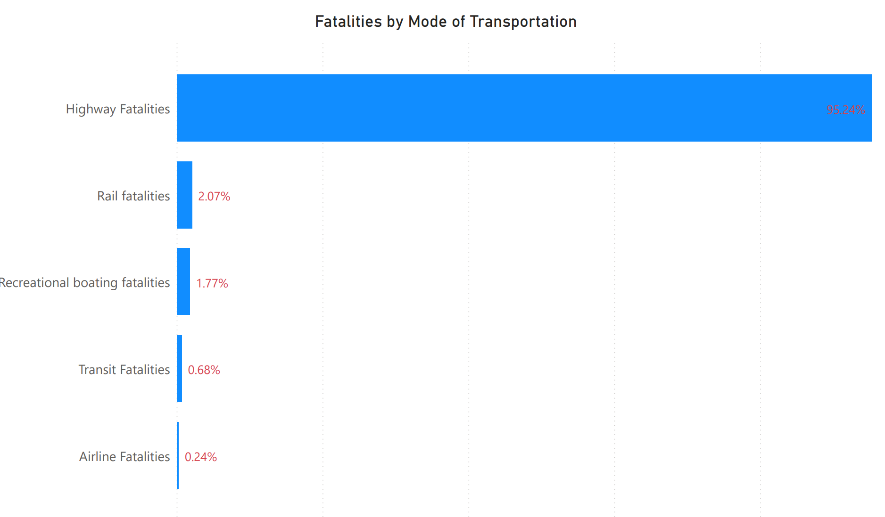
Airlines are the Safest Way to Travel
2010-2020

Slide 3
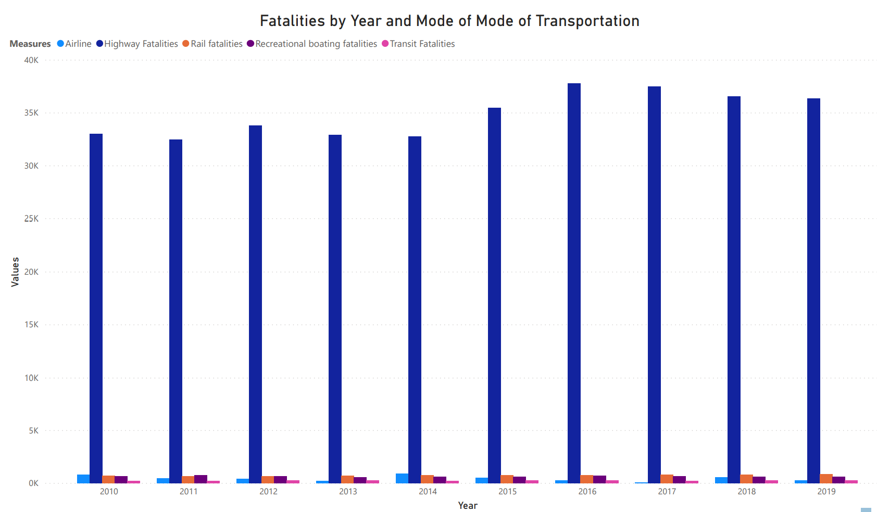
Air vs. highway travel

Slide 4
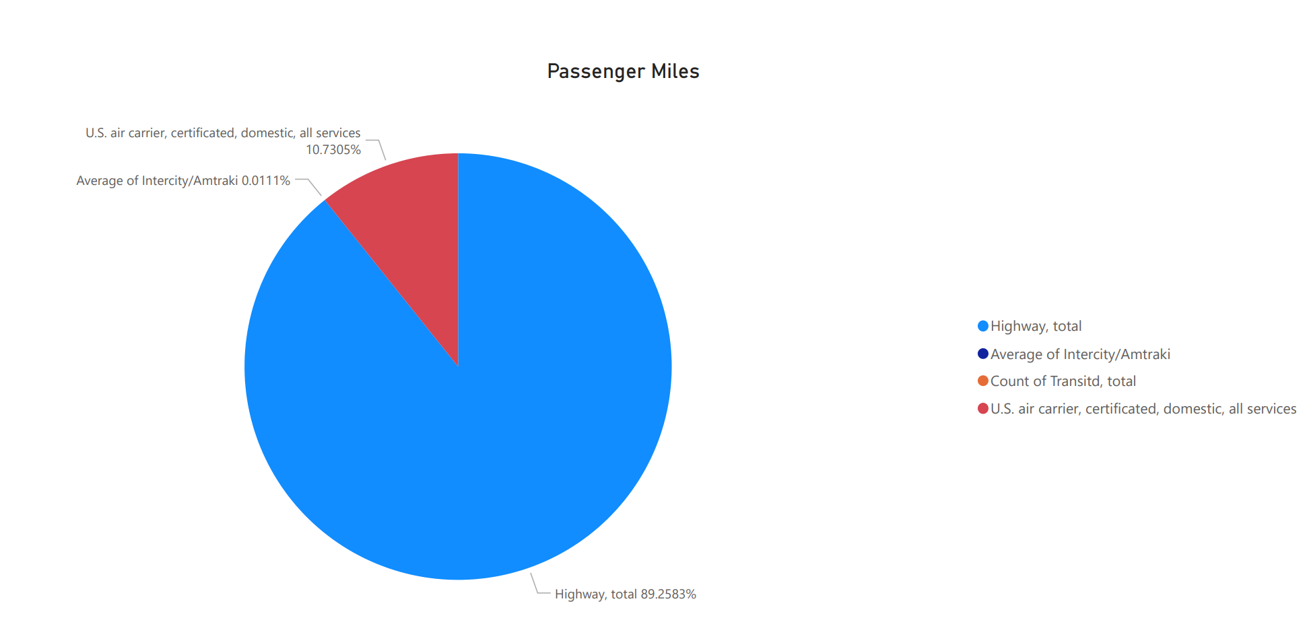
Air Vs. highway Travel
2010-2020
Highway = 89%
Air = 11%
Air accounts for 11% of travel but less than 1% of fatalities.

Slide 5
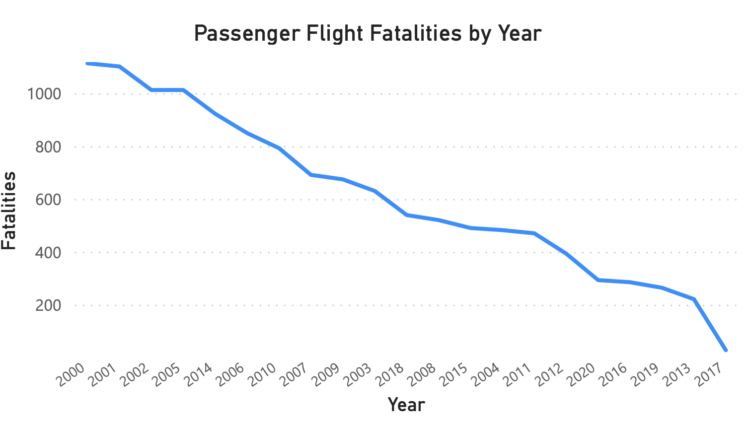
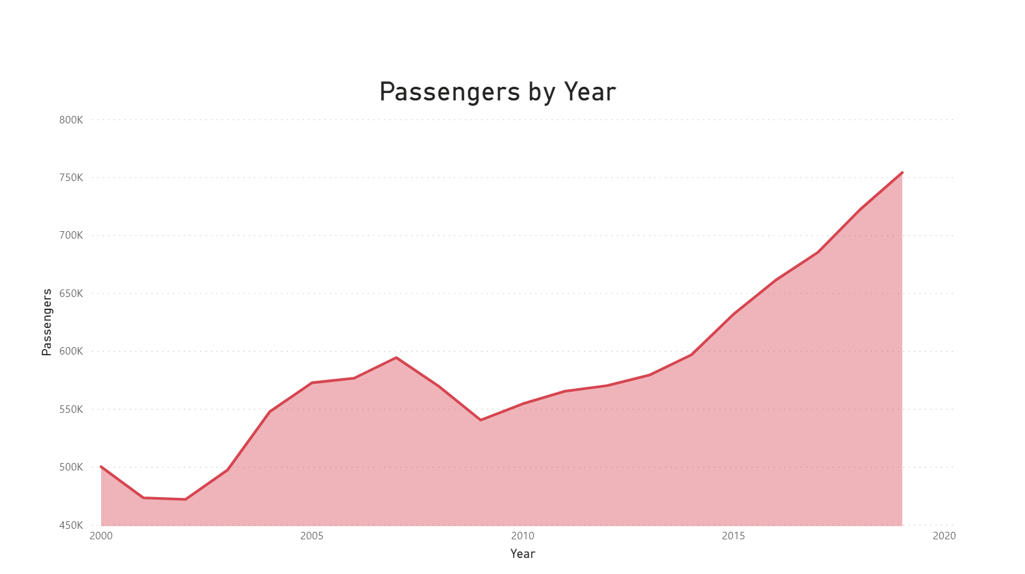
Historical Fatalities and number of passengers

Slide 6
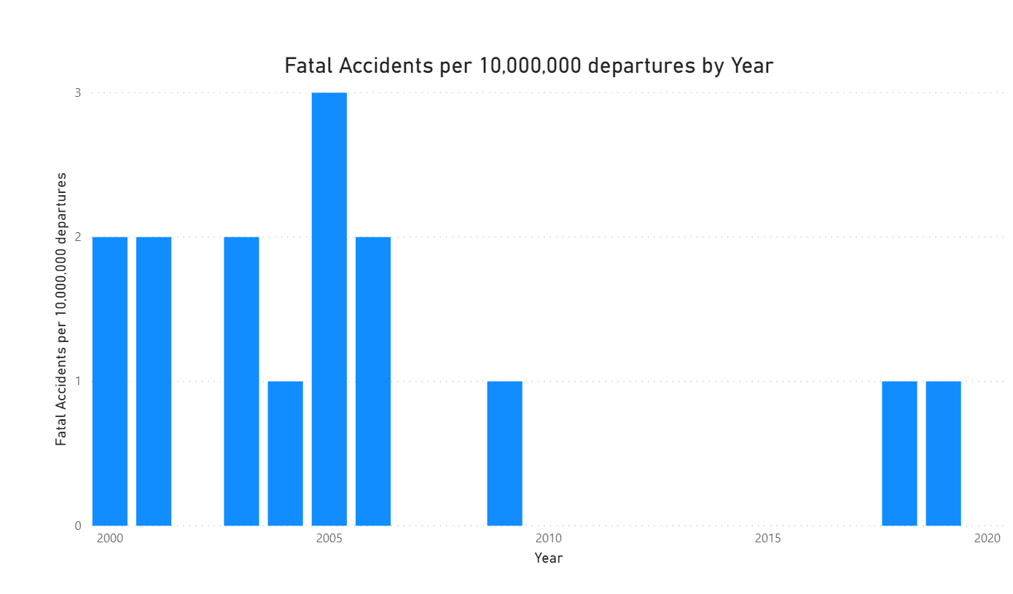
Fatal accidents per 10 million departures

Slide 7
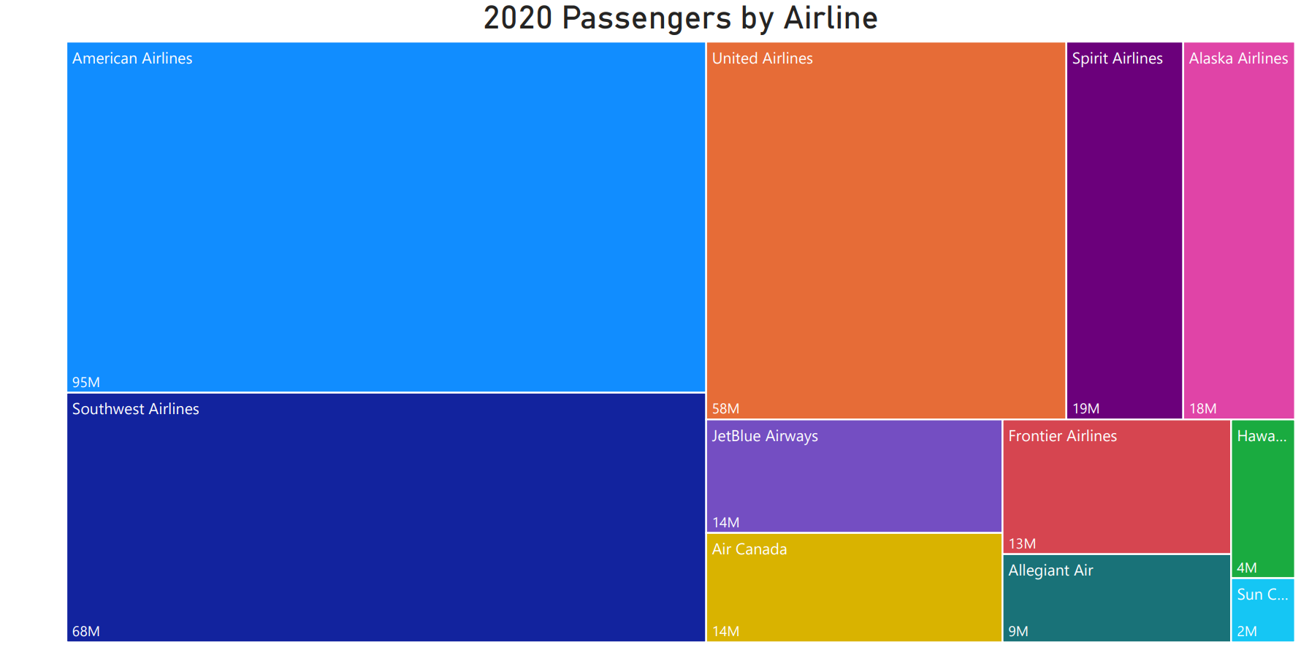
Southwest passenger rating
In 2020, Southwest recorded the second highest number of passengers in the US.

Slide 8
Safety on southwest
Southwest had ZERO fatalities from 2000 - 2014

Slide 9
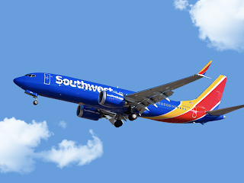
Come Fly safely With Us!

Slide 10
References
https://data.world/fivethirtyeight/airline-safety
https://www.bts.gov/browse-statistical-products-and-data/state-transportation-statistics/ transportation-safety
https://www.airlines.org/dataset/safety-record-of-u-s-air-carriers/
https://www.bts.gov/browse-statistical-products-and-data/state-transportation-statistics/ transportation-safety
https://www.airlines.org/dataset/safety-record-of-u-s-air-carriers/
https://www.airlines.org/dataset/annual-results-world-airlines/
https://www.lifesavvy.com/12075/is-flying-really-safer-than-driving/

